Slide 1
Hastings Museum & Art Gallery
Our Education offer for Schools
Foteini Athanasiadou
Museum Learning Officer
foteini.athanasiadou@hastings.gov.uk

Slide 2
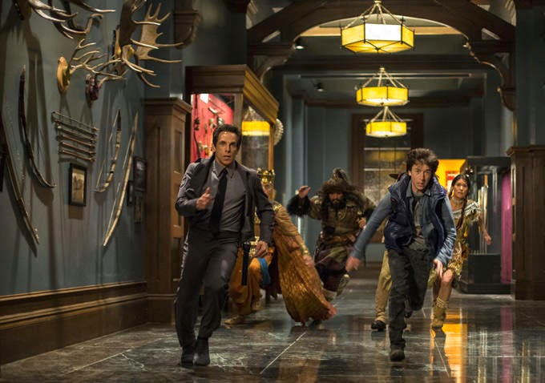
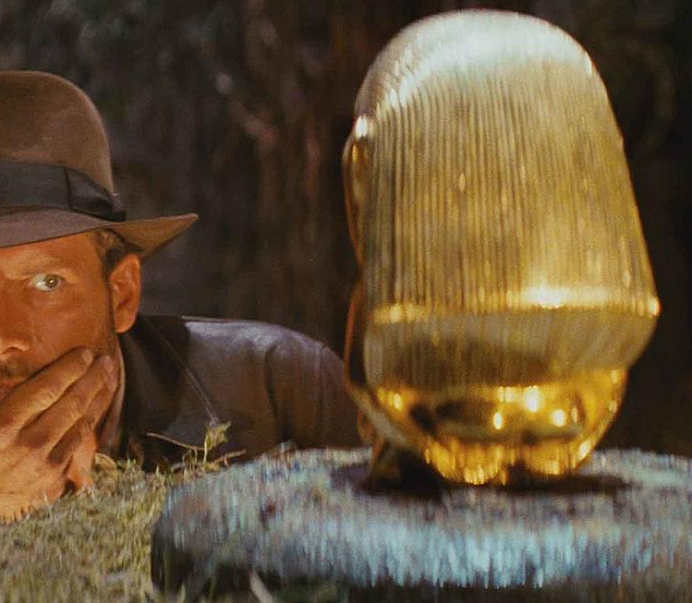
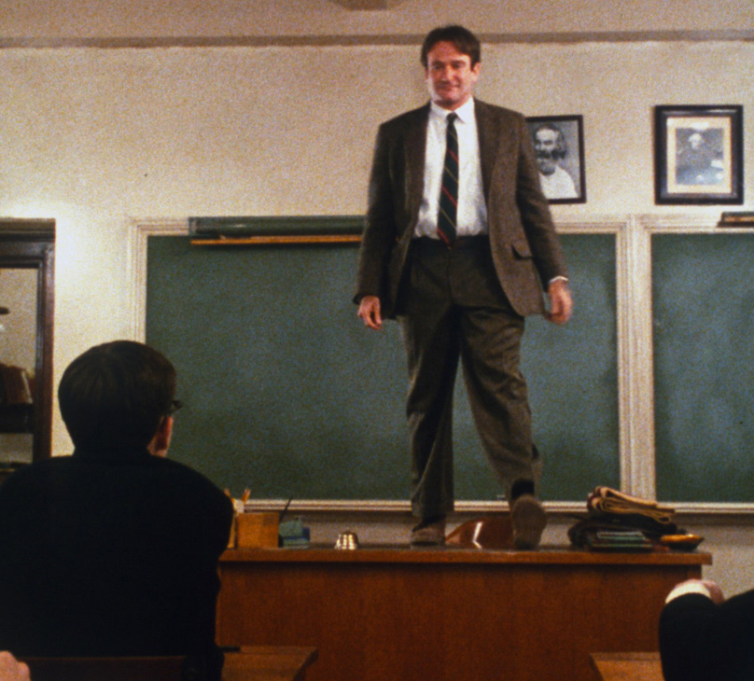
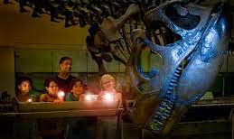
Let me introduce myself ☺

Slide 3
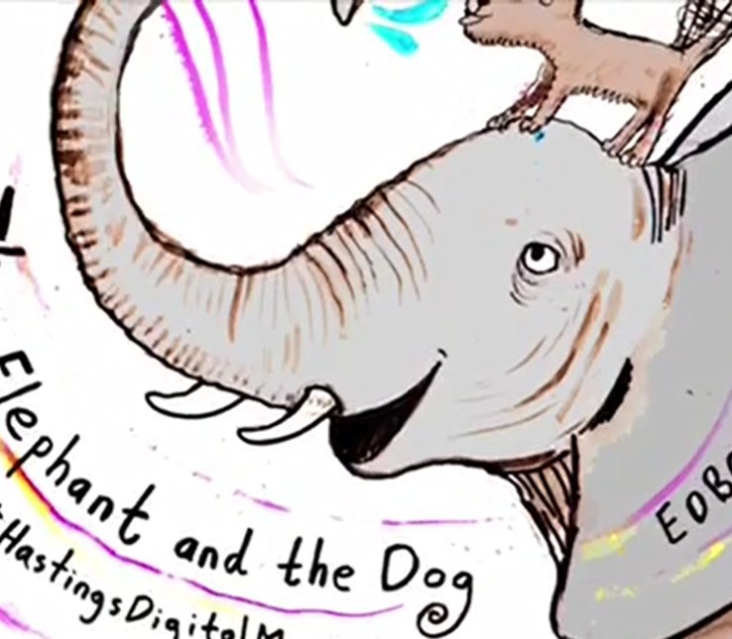
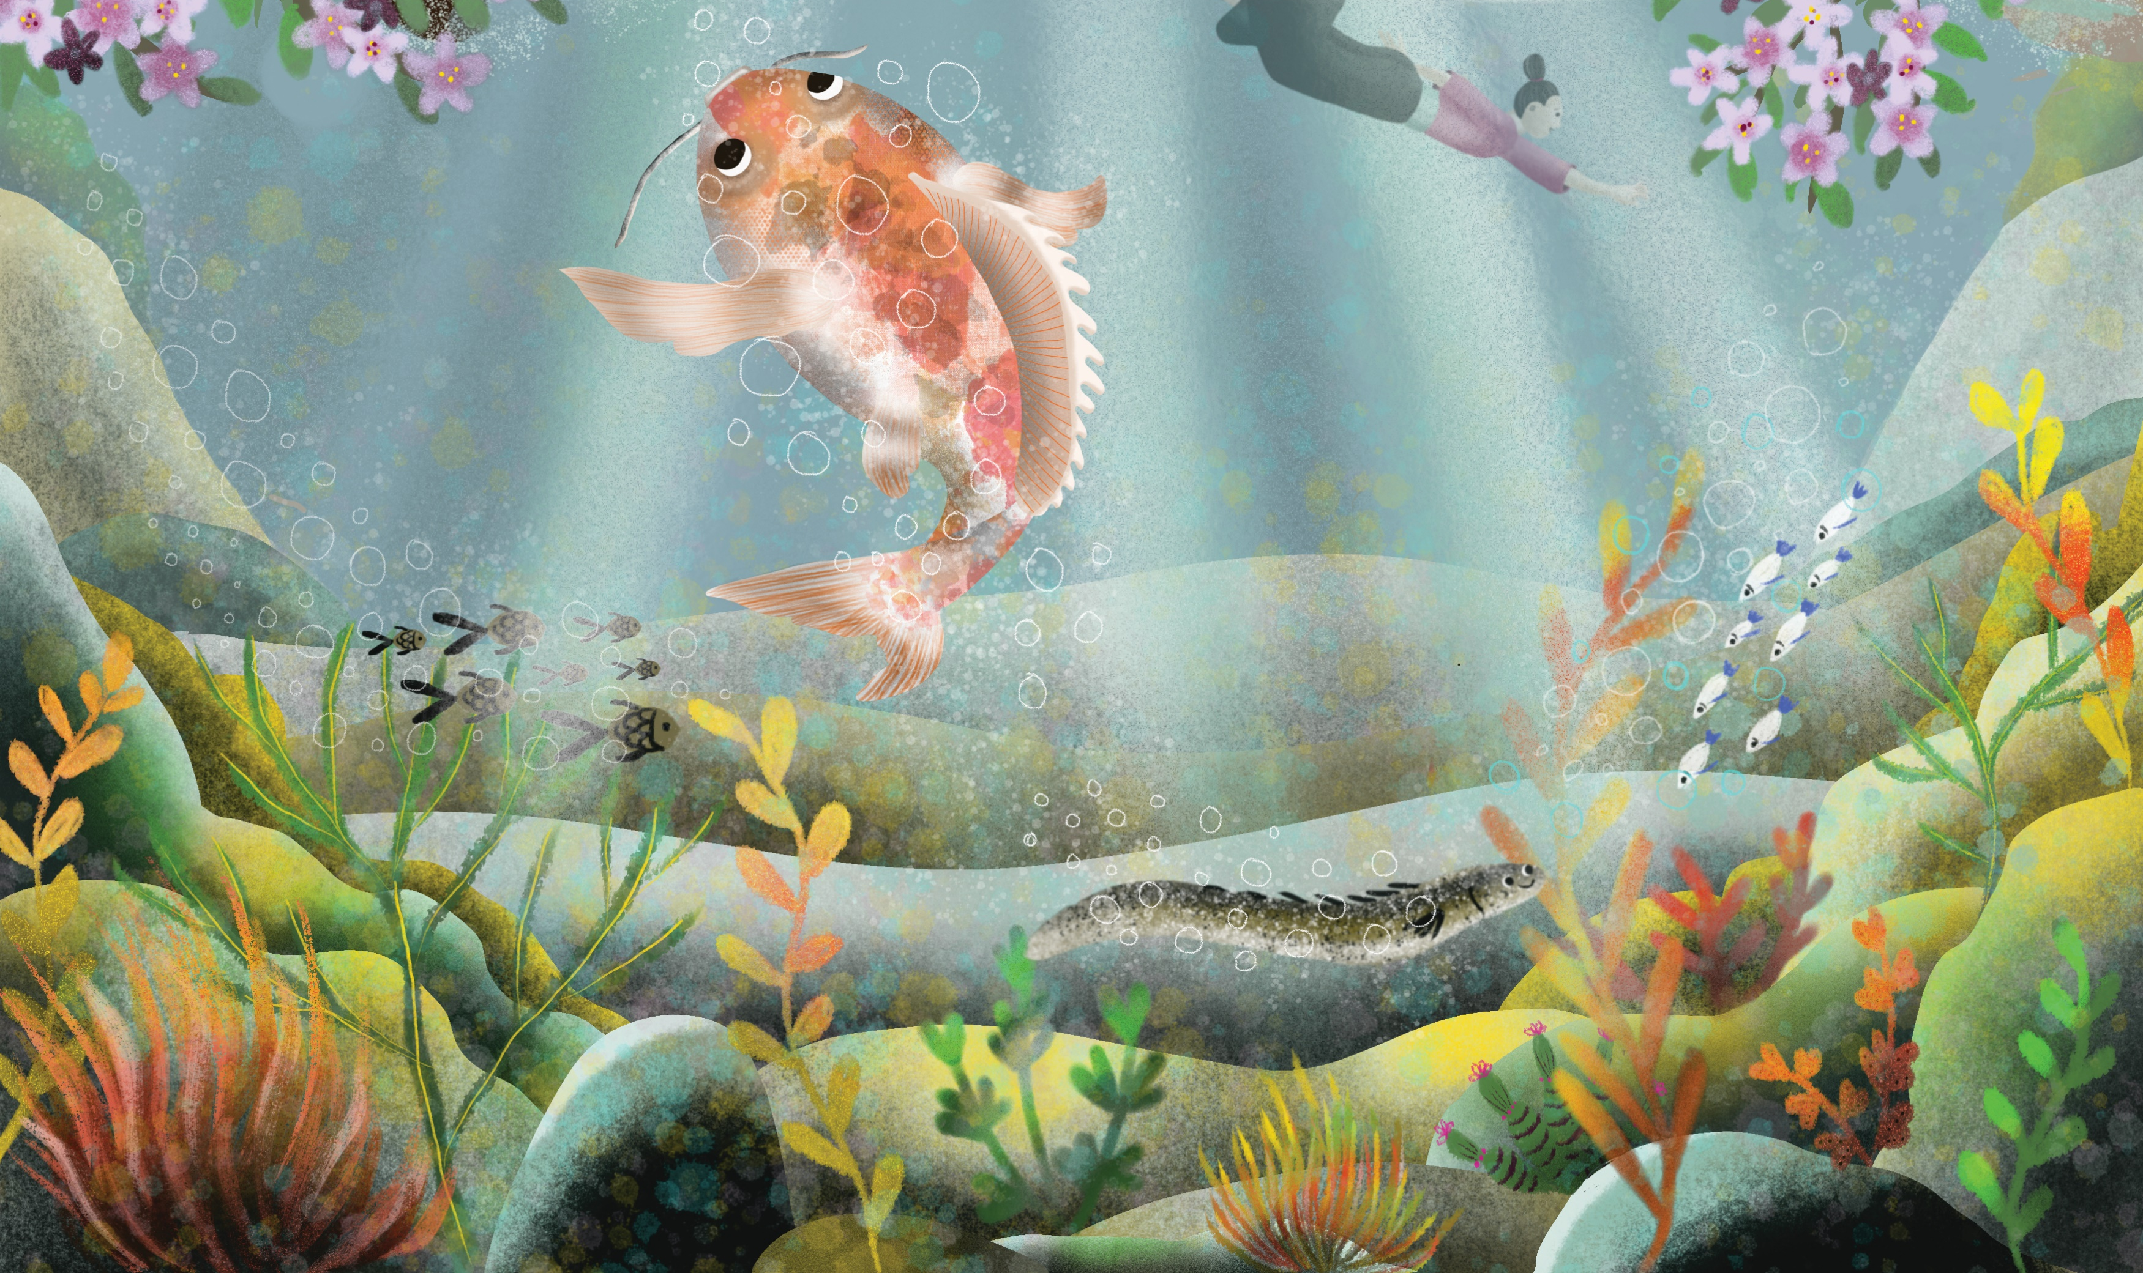
What we have been doing with Artists and schools so far!
We love artists!
We love schools!

Slide 4
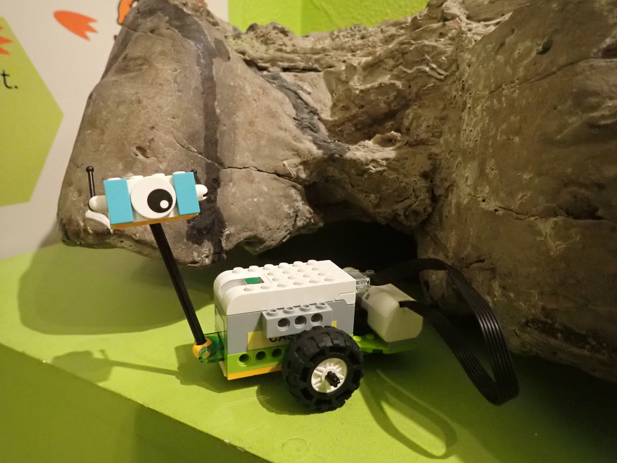
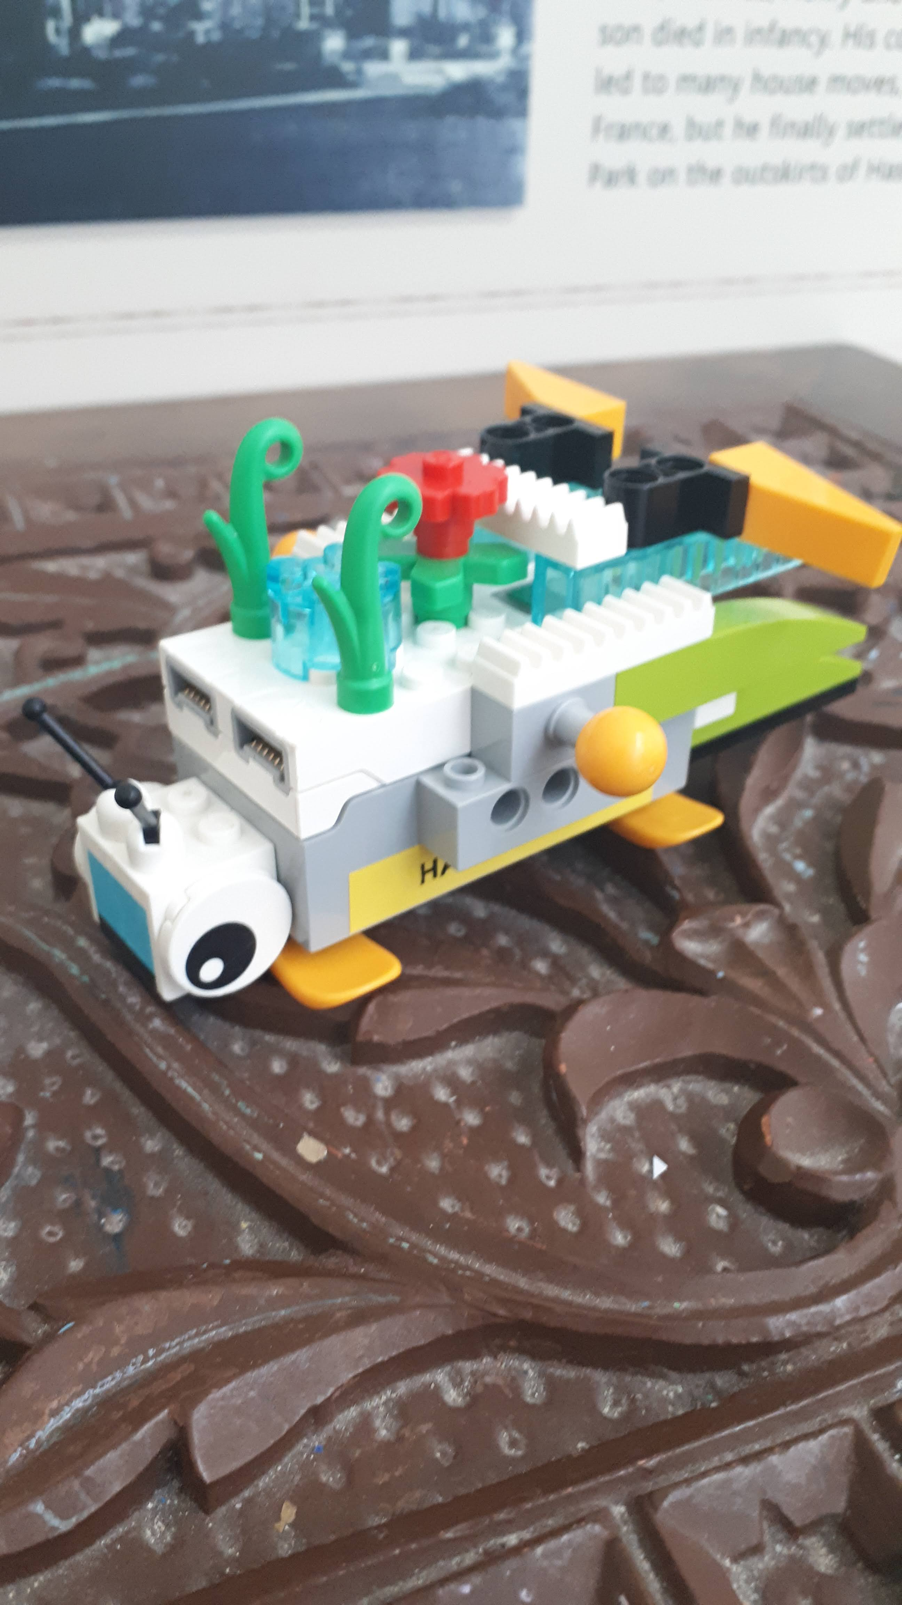
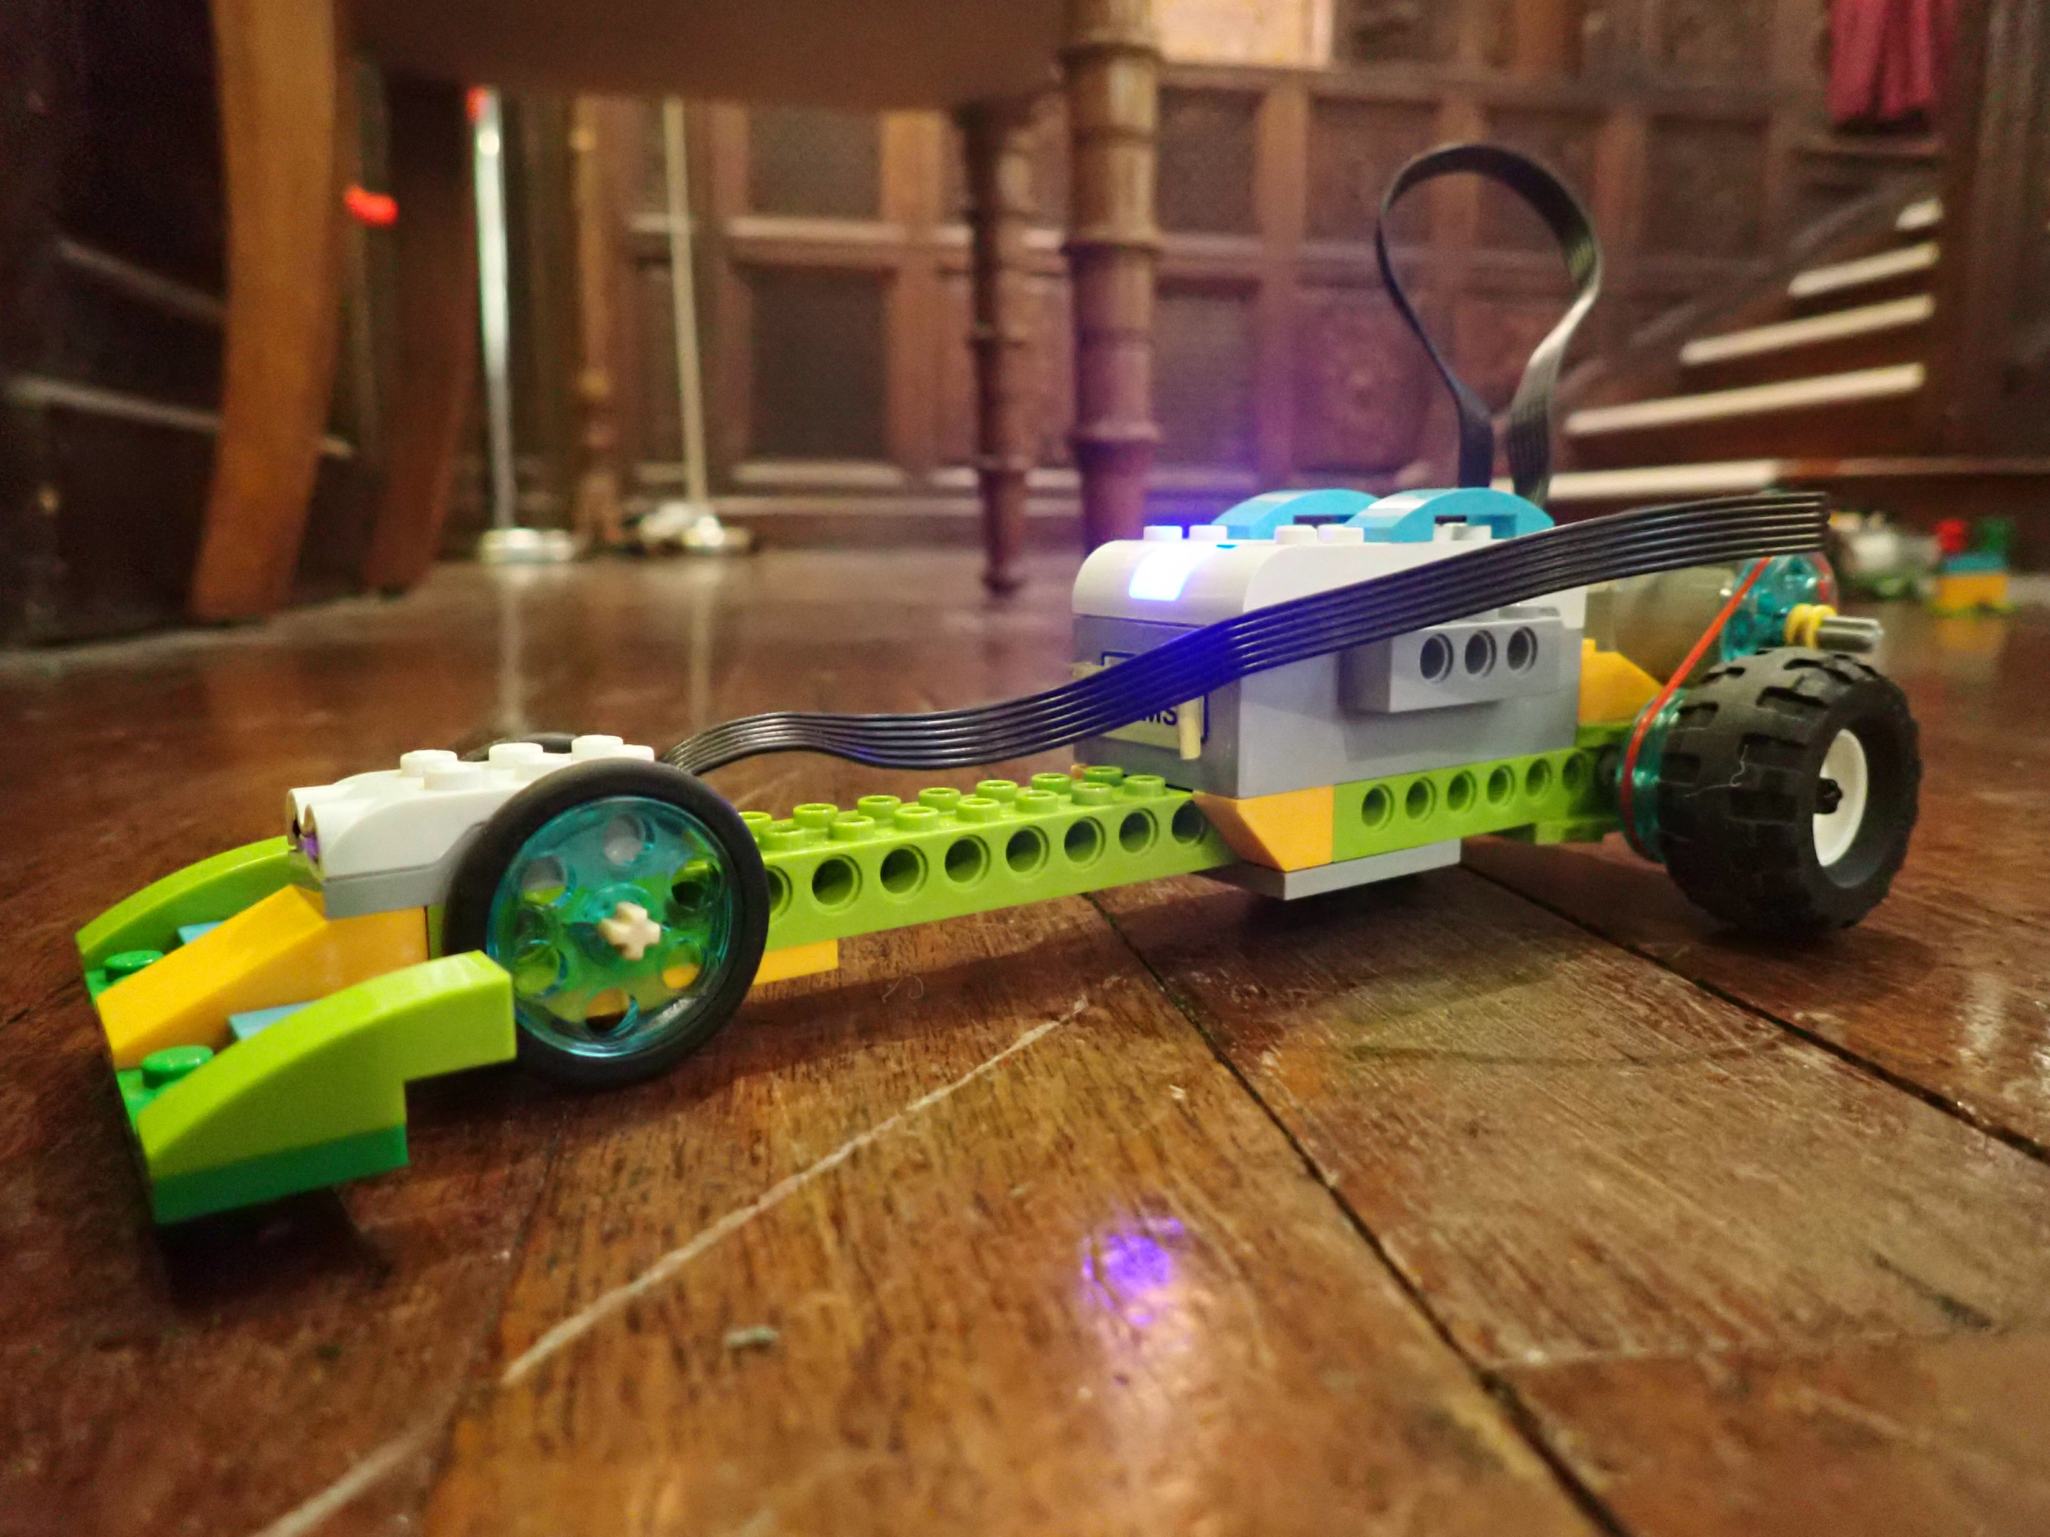

Slide 5
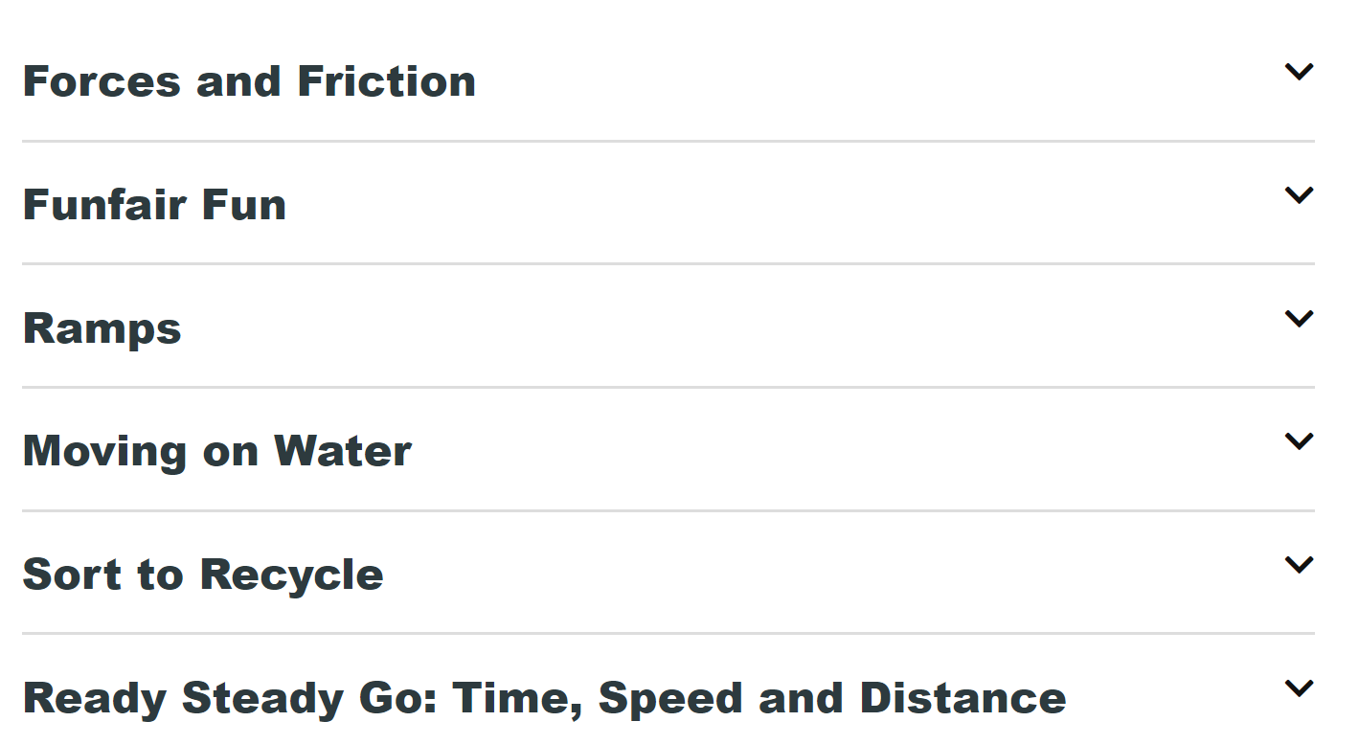

Slide 6
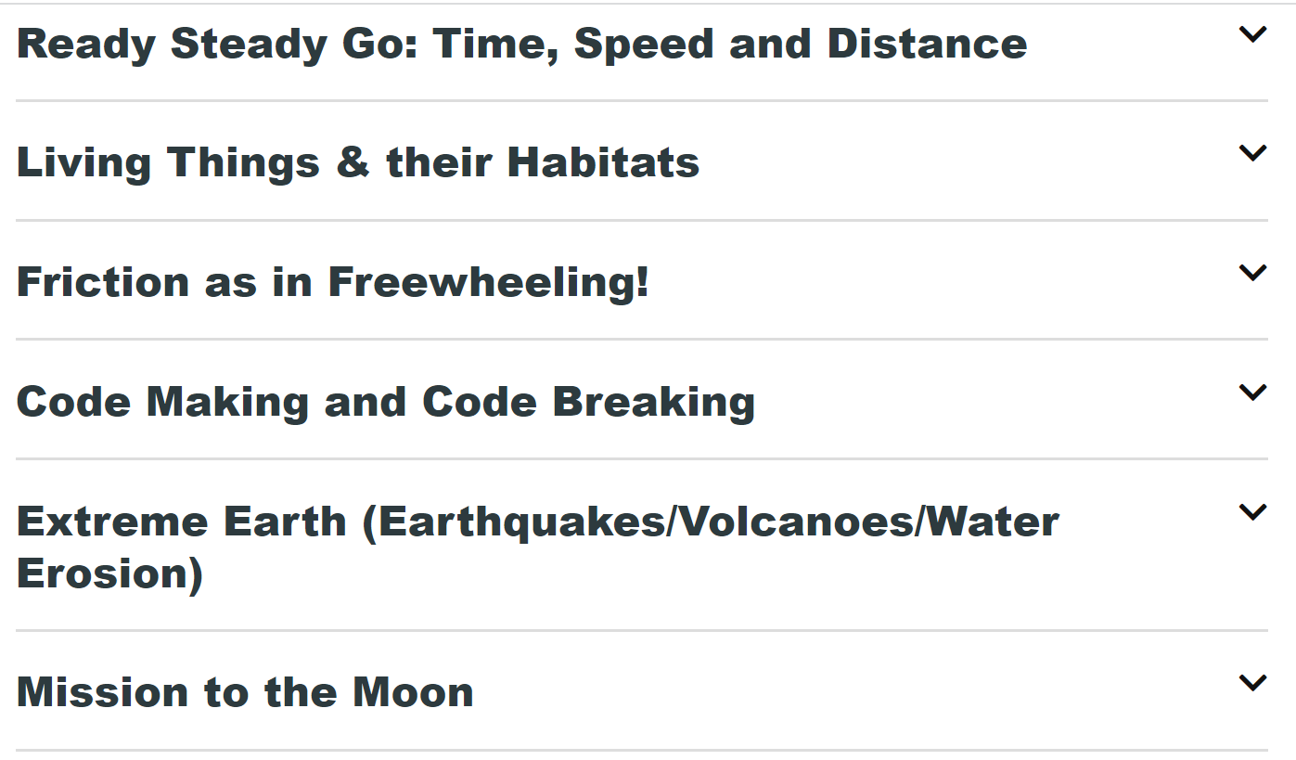

Slide 7
New Direction New Opportunities New Learning

Slide 8
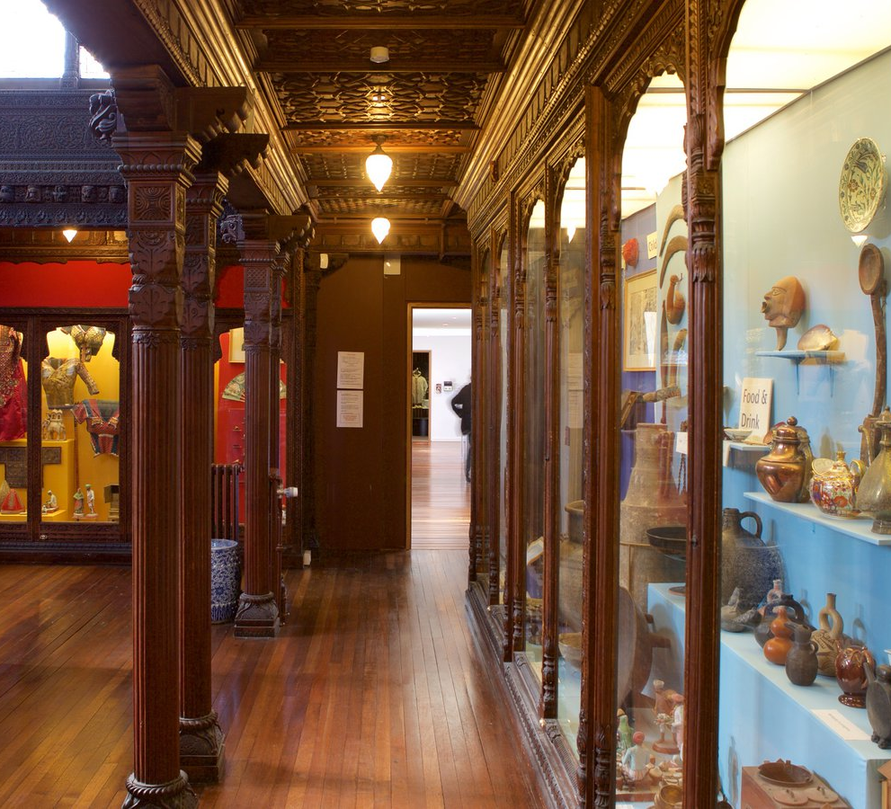
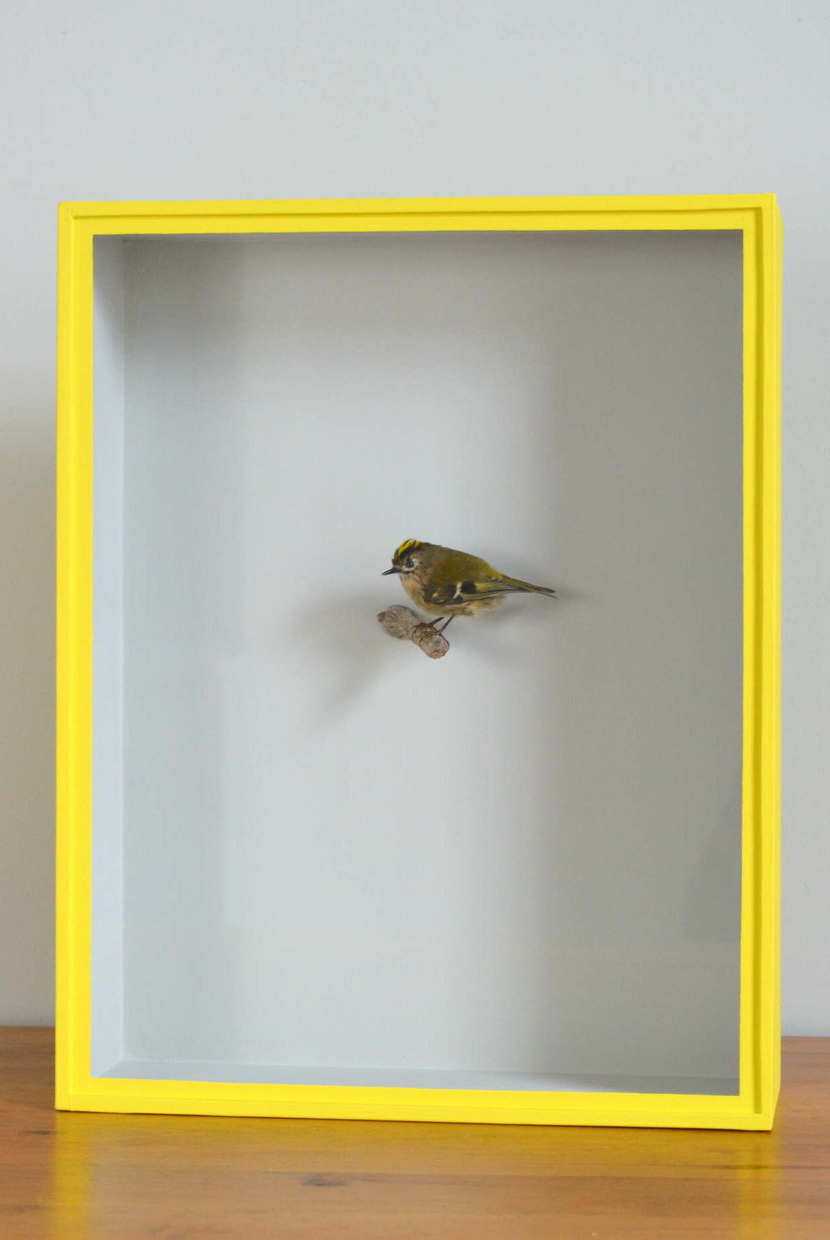
The Artist: Jasmine Miles Long Evolution & Habitats Key Stages: 2 Subject Areas: Science, Technology, Literacy, Art Length of Session: 1 hour 30 mins Delivery: On site

Slide 9
the Writer: Kate Hulme Midnight in the Museum with Old toys Key Stages: 1 Subject Areas: Literacy Oracy, PSHE, history Length of Session: 2 hours Delivery: On site

Slide 10
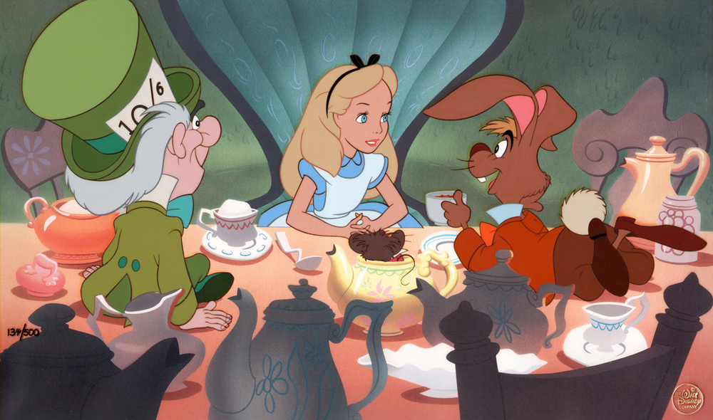
Teachers for Tea Opportunity: Connect with your peers Use HMAG as an extension of your classroom Shape it Make your voice heard Tell us how we can benefit your practice foteini.athanasiadou@hastings.gov.uk

Slide 11
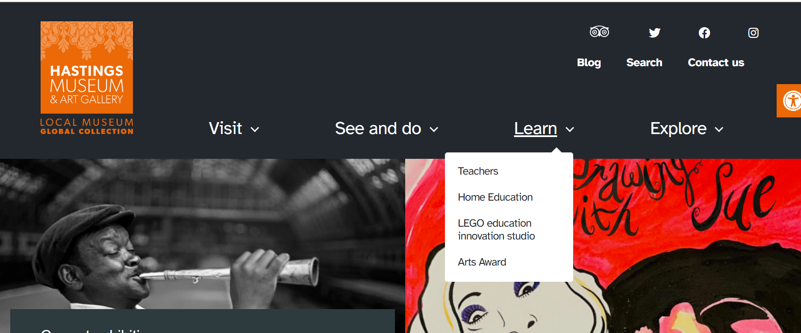
Great News!
HMAG New website

Slide 13
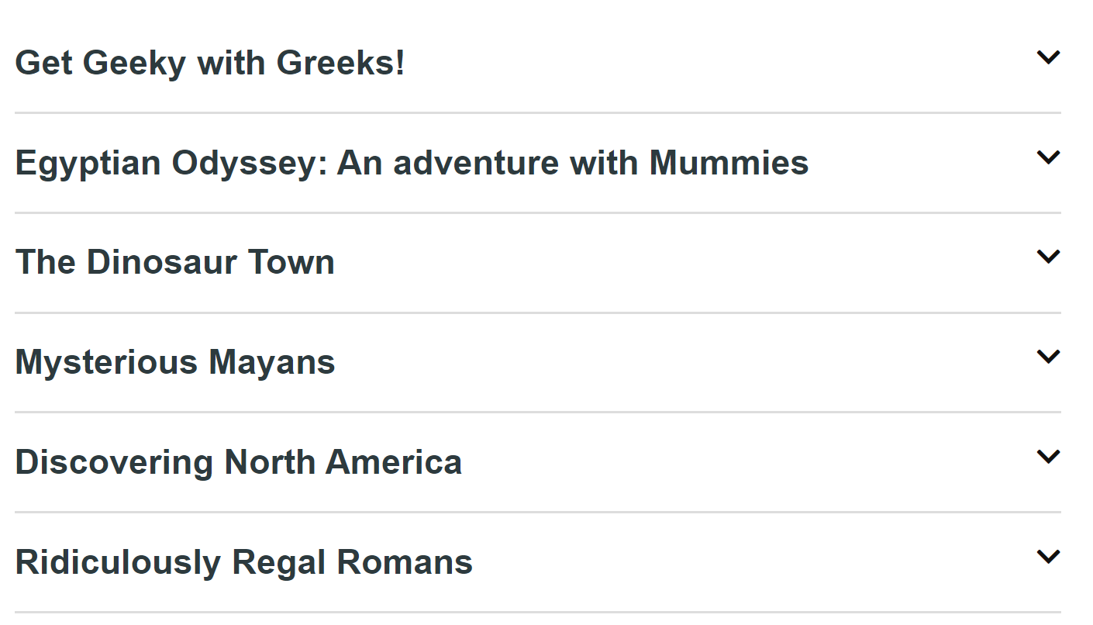

Slide 14
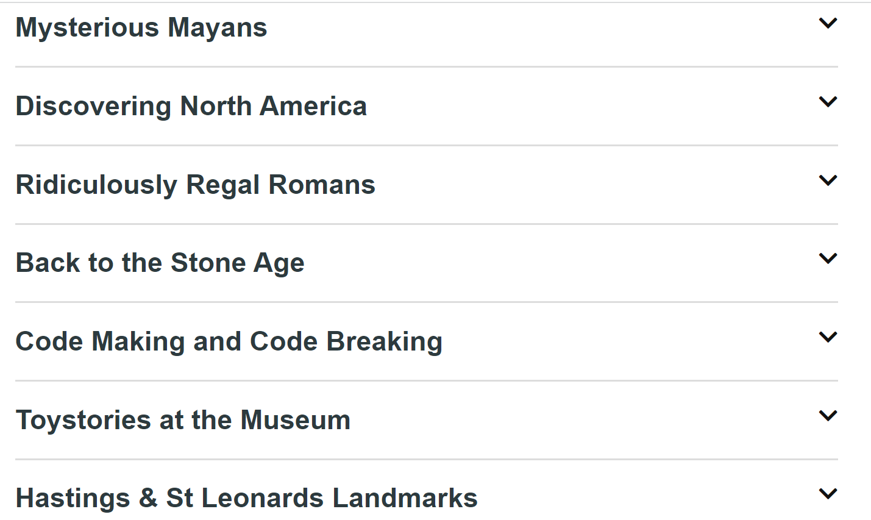

Slide 15
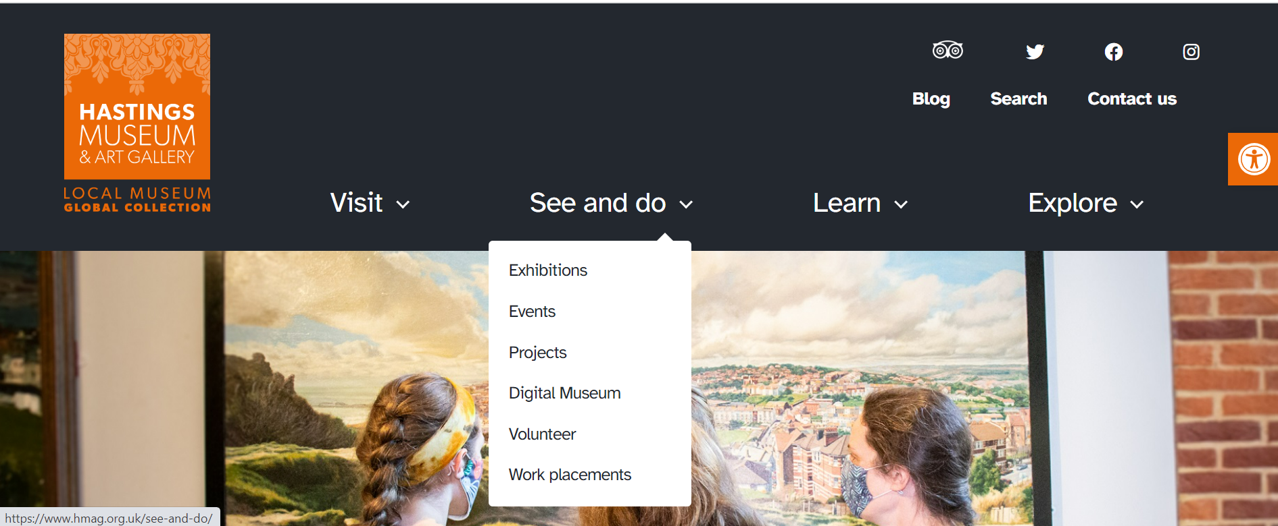
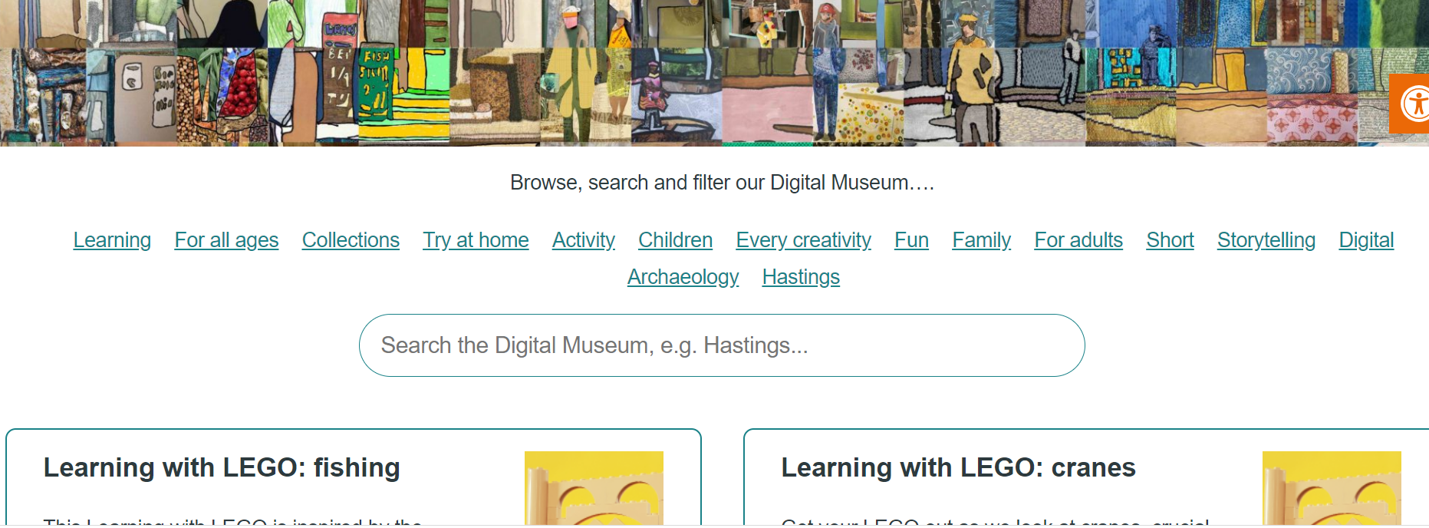

Slide 16
Coming up: Mary in the Margins Lego Lab Projects garden Library PROGRAMME (BOOKCLUB September Launch) Follow that duck New Workshops (Victorians, GREY owl landmarks, Bronze age etc)

Slide 17
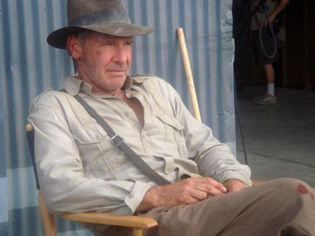
Get in touch
foteini.athanasiadou@hastings.gov.uk

