Slide 1

Hastings & Rother Arts Education Network
Tuesday 29th September 2015

Slide 2


Artsmark
Arts Council England’s refreshed Artsmark launches in October 2015
The new award is designed by schools, for schools and will support deeper connections with schools’ own strategies, aligning with school curriculum and planning cycles. It will support schools to improve their artistic practice and outcomes for their students and to build new and exciting partnerships with arts, heritage and cultural organisations.
Introduction Day for schools
Wednesday 21st October at Bexhill Museum
Schools can register their interest in attending by emailing claire@artswork.org.uk
For further information, please contact
Jane Dickson, Schools Liaison Manager for Sussex, Surrey, Brighton & Hove janedickson@artswork.org

Slide 3


Slide 4

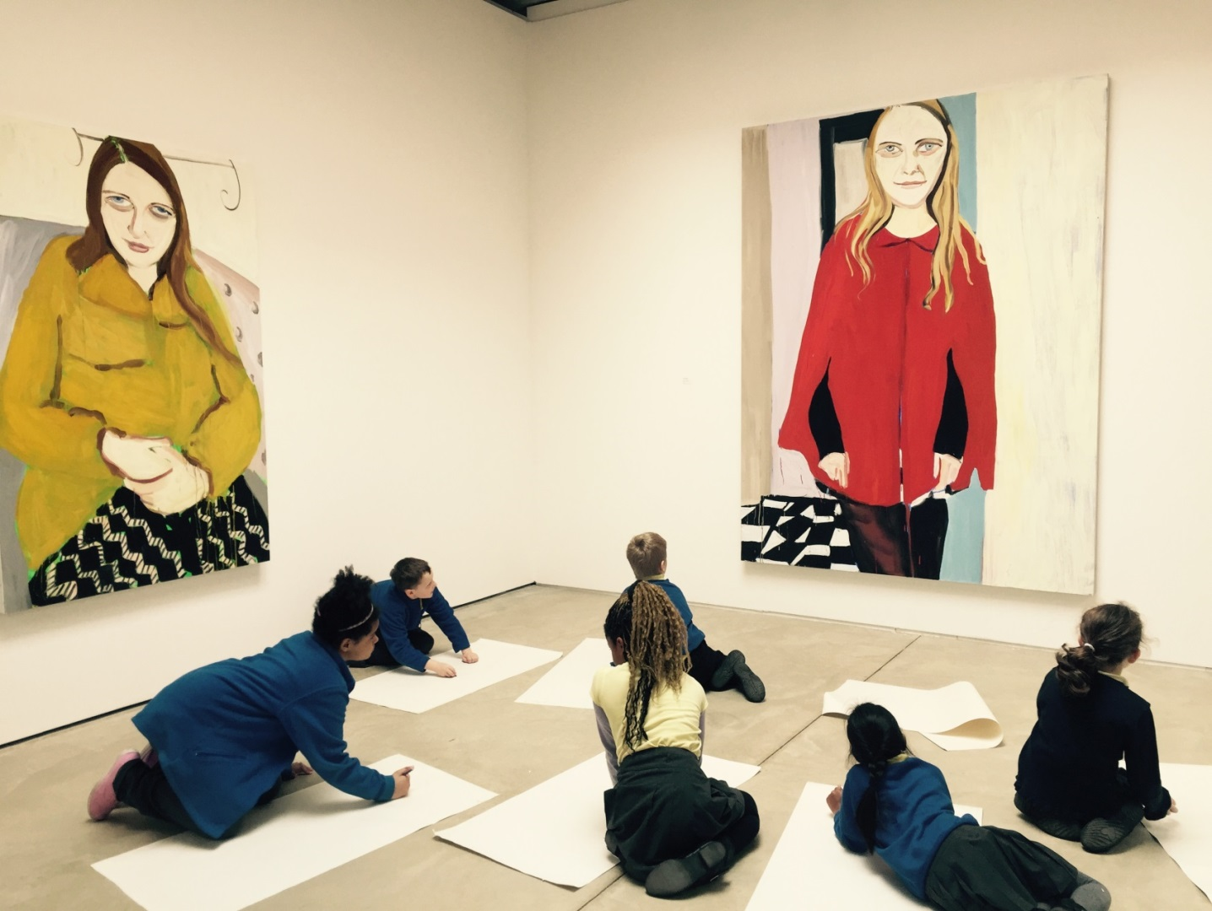
PEARLS OF THE SEA
2 visits to Jerwood gallery twice a year
Creative CPD sessions
Teachers networking event
Celebration exhibition of children’s work
If you would like more information please email:
emily@jerwoodgallery.org

Slide 5



A week-long festival of story telling for children and adults
Storyteller in Residence: Usifu Jalloh – particularly for schools with Sierra Leone links.
A free 1-2 hour CPD opportunity for teachers on Thursday November 12th: The Natasha Project : Workshop: Teaching about human trafficking and modern-day slavery.
Next storytelling teacher meeting 4pm Monday 5th October, Rock House, Hastings Town Centre.

Slide 6
Culture Shift
Your Museum: Your Say Hastings Museum and Art Gallery Consultation
Saturday 10 October 2.00-4.00pm
Creative session to inform future plans for the museum. All welcome.
Book with Culture Shift catherine@cultureshift.org.uk
Arts Award Training – Gold Top Up
Friday 2 October 1.45-5.00pm, Lighthouse, Brighton
Book online www.artsaward.org.uk
Arts Award Surgery
Thursday 3 December 2.00-5.00pm, Brighton Museum and Art Gallery
Book http://www.artsawardkent.co.uk/already-an-arts-award-adviser

Slide 7
Current exhibitions
Rooftop Foyer
Platform Graduate Showcase 2015 - until 1 November
Gallery 2
Towards an alternative history of graphic design - until 4 October
Cy Twombly: Quattro Stagioni - 24 October until 10 January
Gallery 1
In The Realm of Others, Project Art Works - until 29 November
FREE Teachers’ introduction and CPD led by artist Sharon Haward on 30 September 4 – 6 pm
FREE workshop exploring themes from the exhibition led by artist Sharon Haward
Year 5, Thursday 5 November 10 am – 2.45 pm
Year 9, Thursday 12 November 10 am – 2.45 pm
You can book workshop places with ashley.mccormick@dlwp.com 01424 229 103

Slide 8

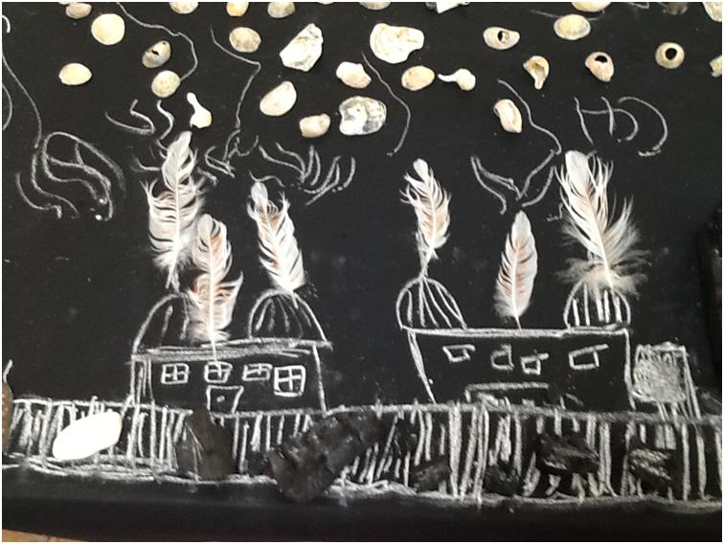
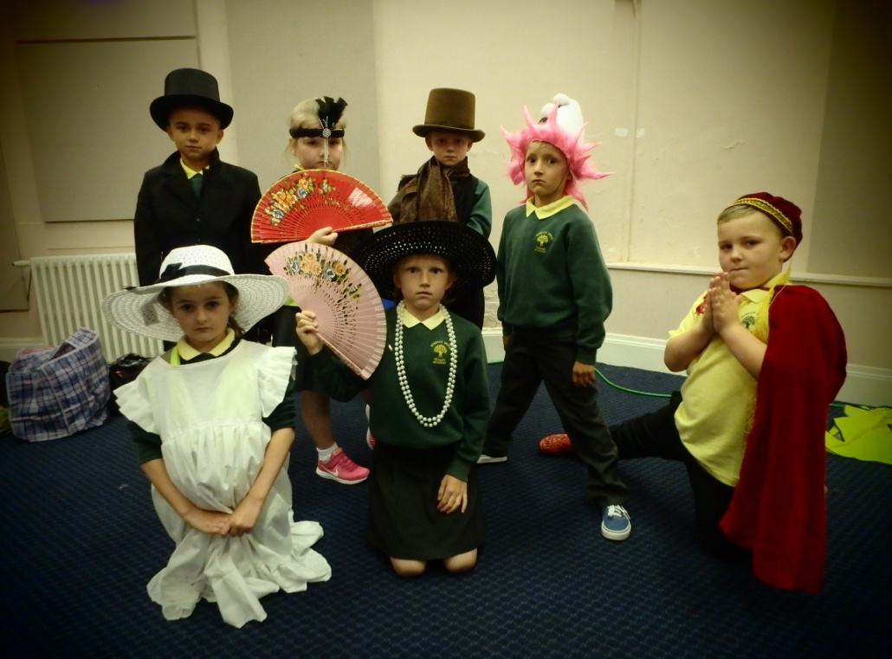
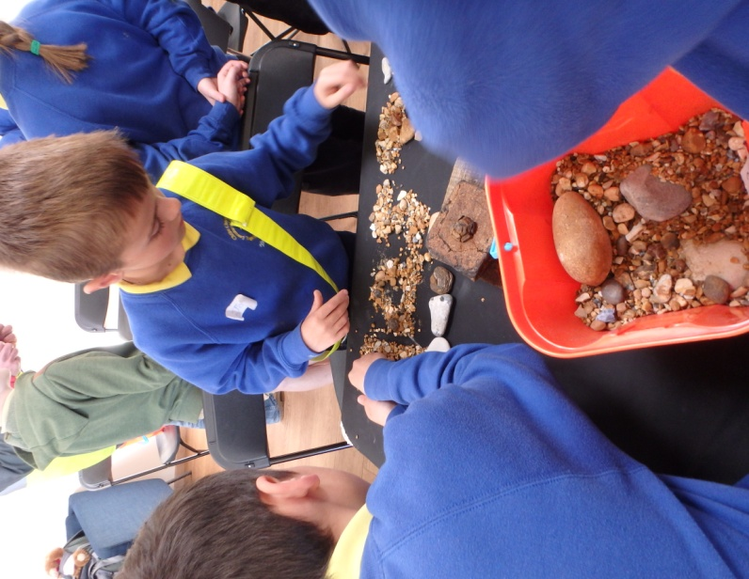
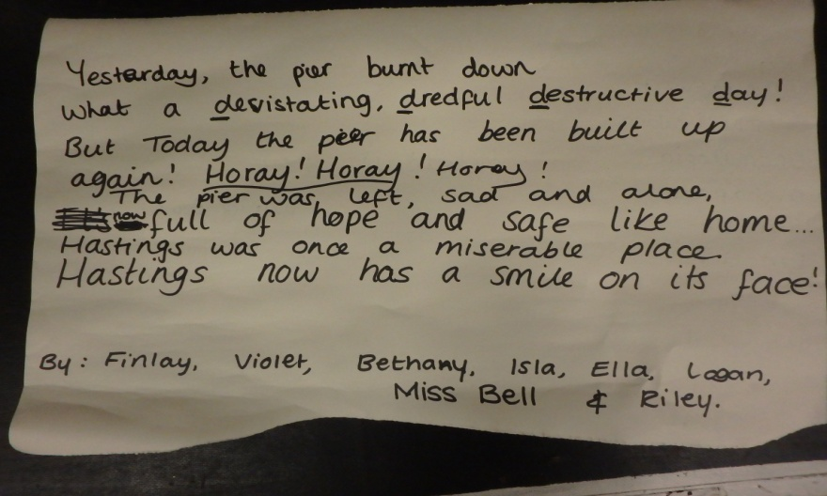
We are currently offering the following FREE
Schools workshop
KS1/2 History detectives with an introduction
to Pier engineering (Oct 2015)
We will be offering more schools workshops, theme days
and projects from April 2016 when the Pier reopens.
We are also offering FREE drop in and bookable
family workshops based at the Pier Hub.
Future activities include plaster name plaques
and zinc Christmas decorations.
For further information and to receive the latest offers
join the email Learning Network –
learning@hpcharity.co.uk
or contact susan.kent@hpcharity.co.uk.
Photography and Poetry Theme Days

