Slide 1
#LetsCreate
Wifi available #culturematters

Slide 2
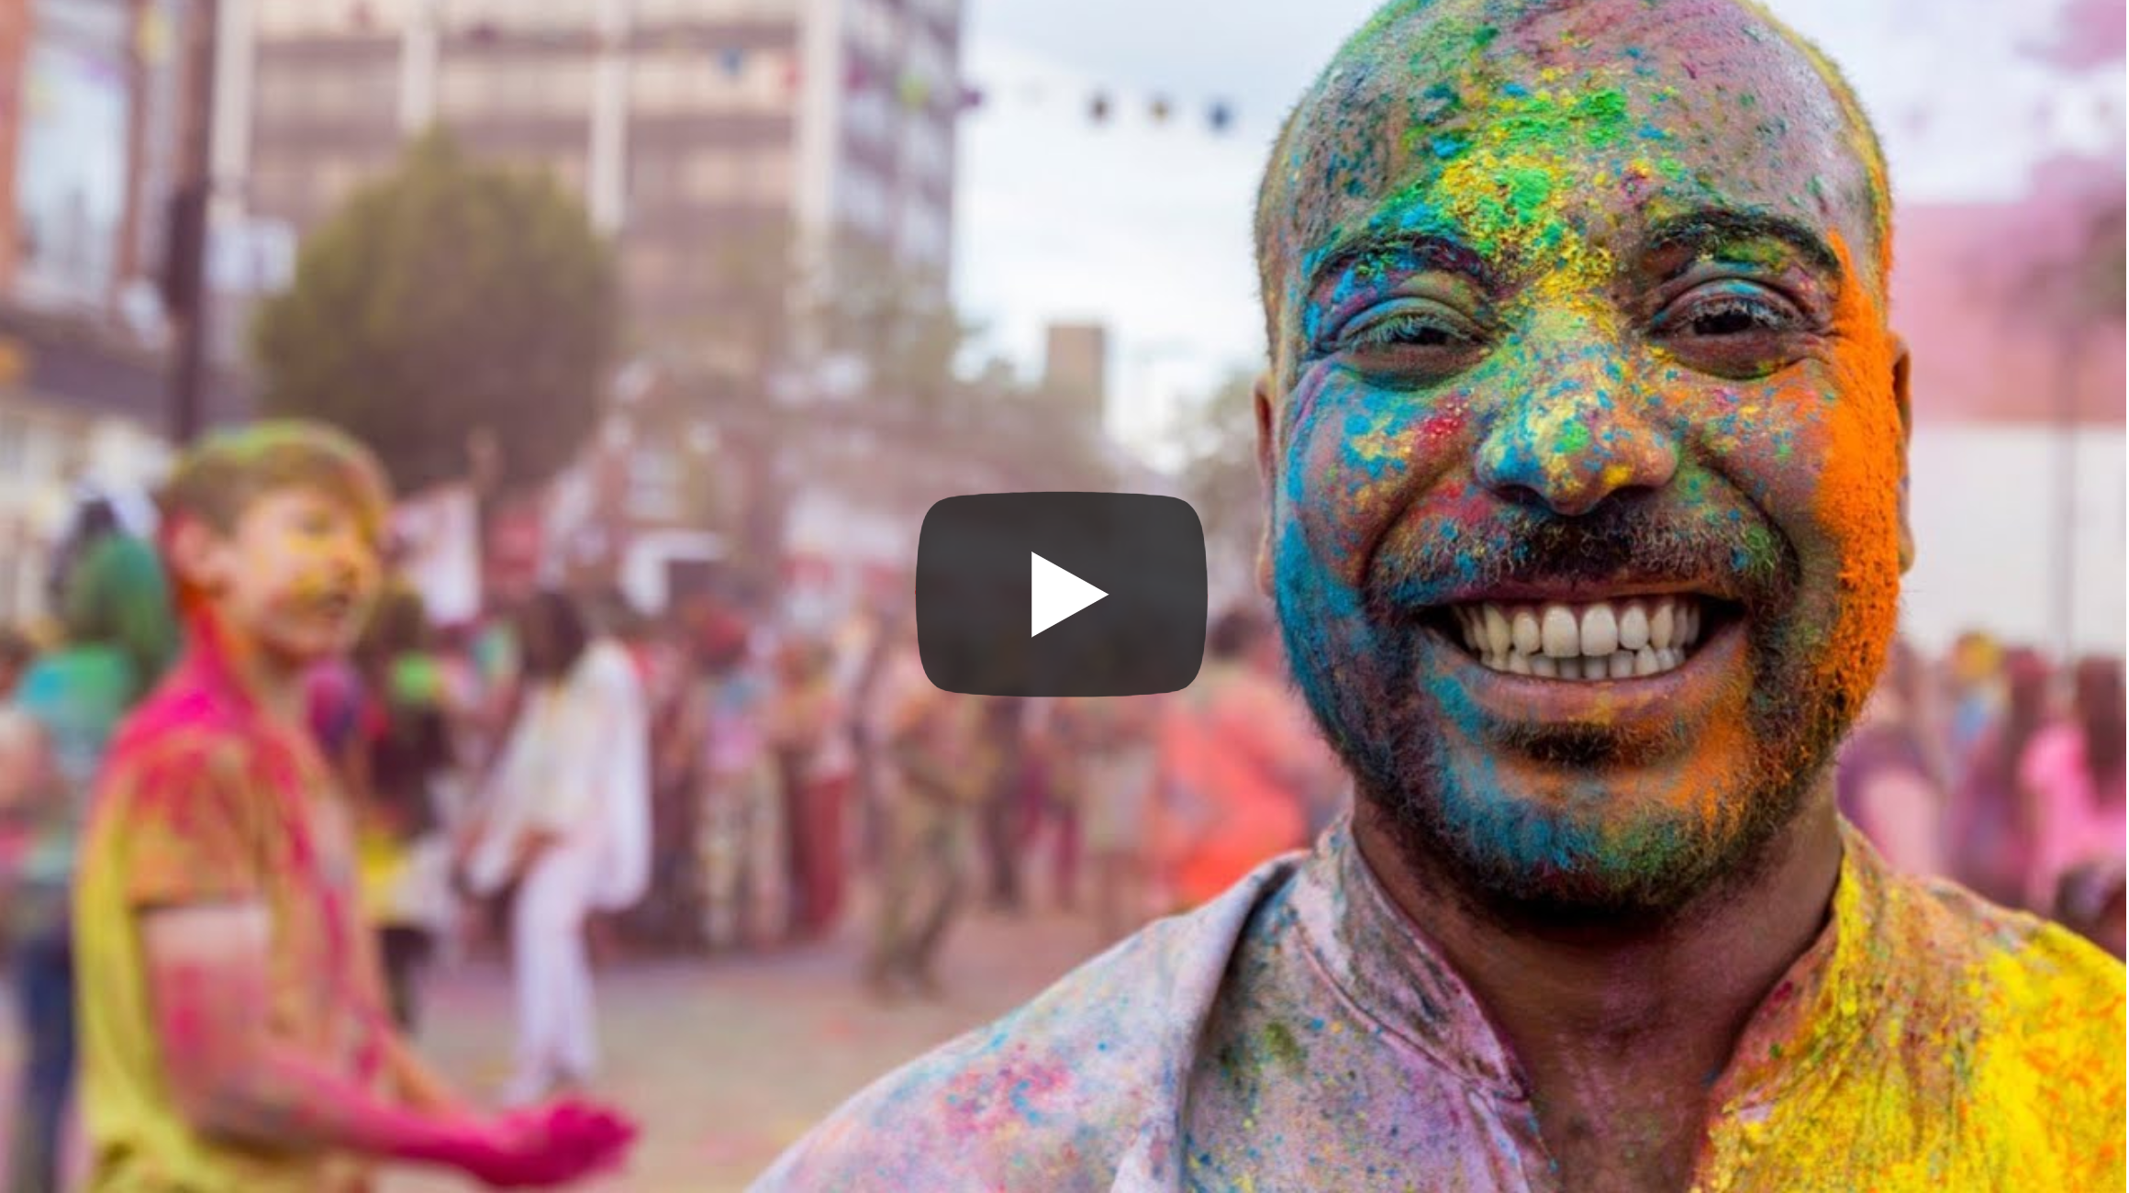
#LetsCreate
REMEMBER: SELECT CAPTIONS IN YOUTUBE
Wifi available #culturematters

Slide 3
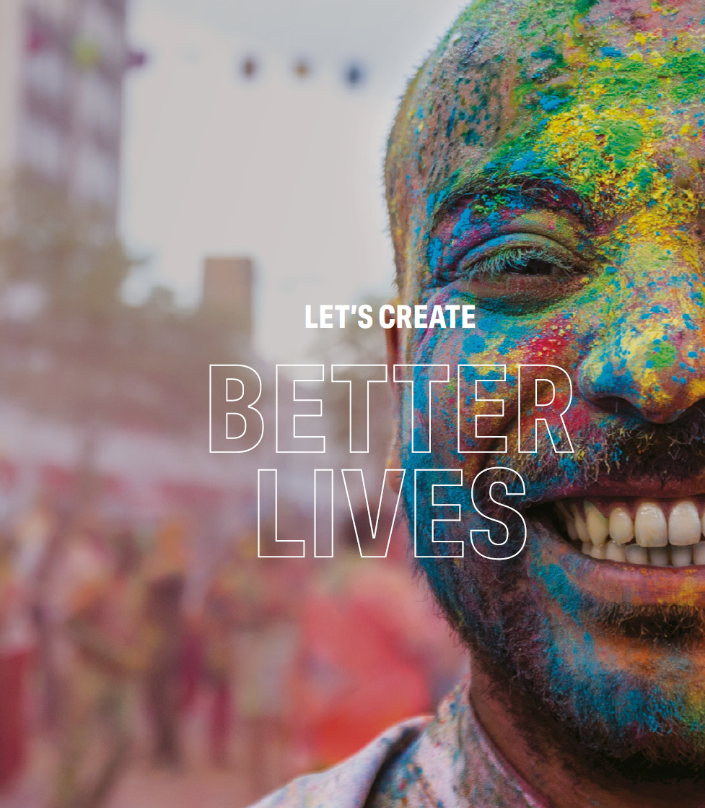
#LetsCreate
Our vision:
By 2030, we want England to be a country in which the creativity of each of us is valued and given the chance to flourish, and where every one of us has access to a remarkable range of high-quality cultural experiences.
Wifi available #culturematters

Slide 4
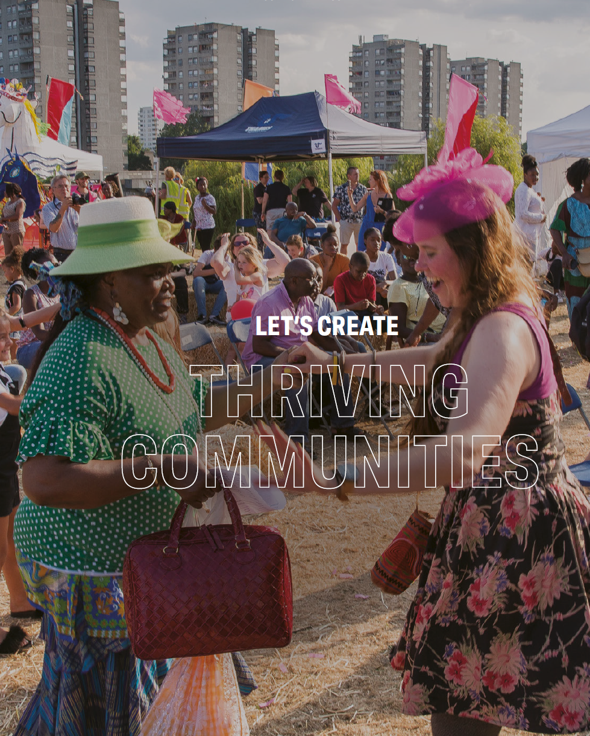
#LetsCreate
How we’ll realise our vision:
This vision is articulated by three Outcomes we will work towards. Both the Arts Council and the organisations and people we invest in will need to change to meet them. We have four Investment Principles that will help steer that change. By committing to them, organisations will be better able to deliver the outcomes and provide even greater benefit to the public.
Wifi available #culturematters

Slide 5
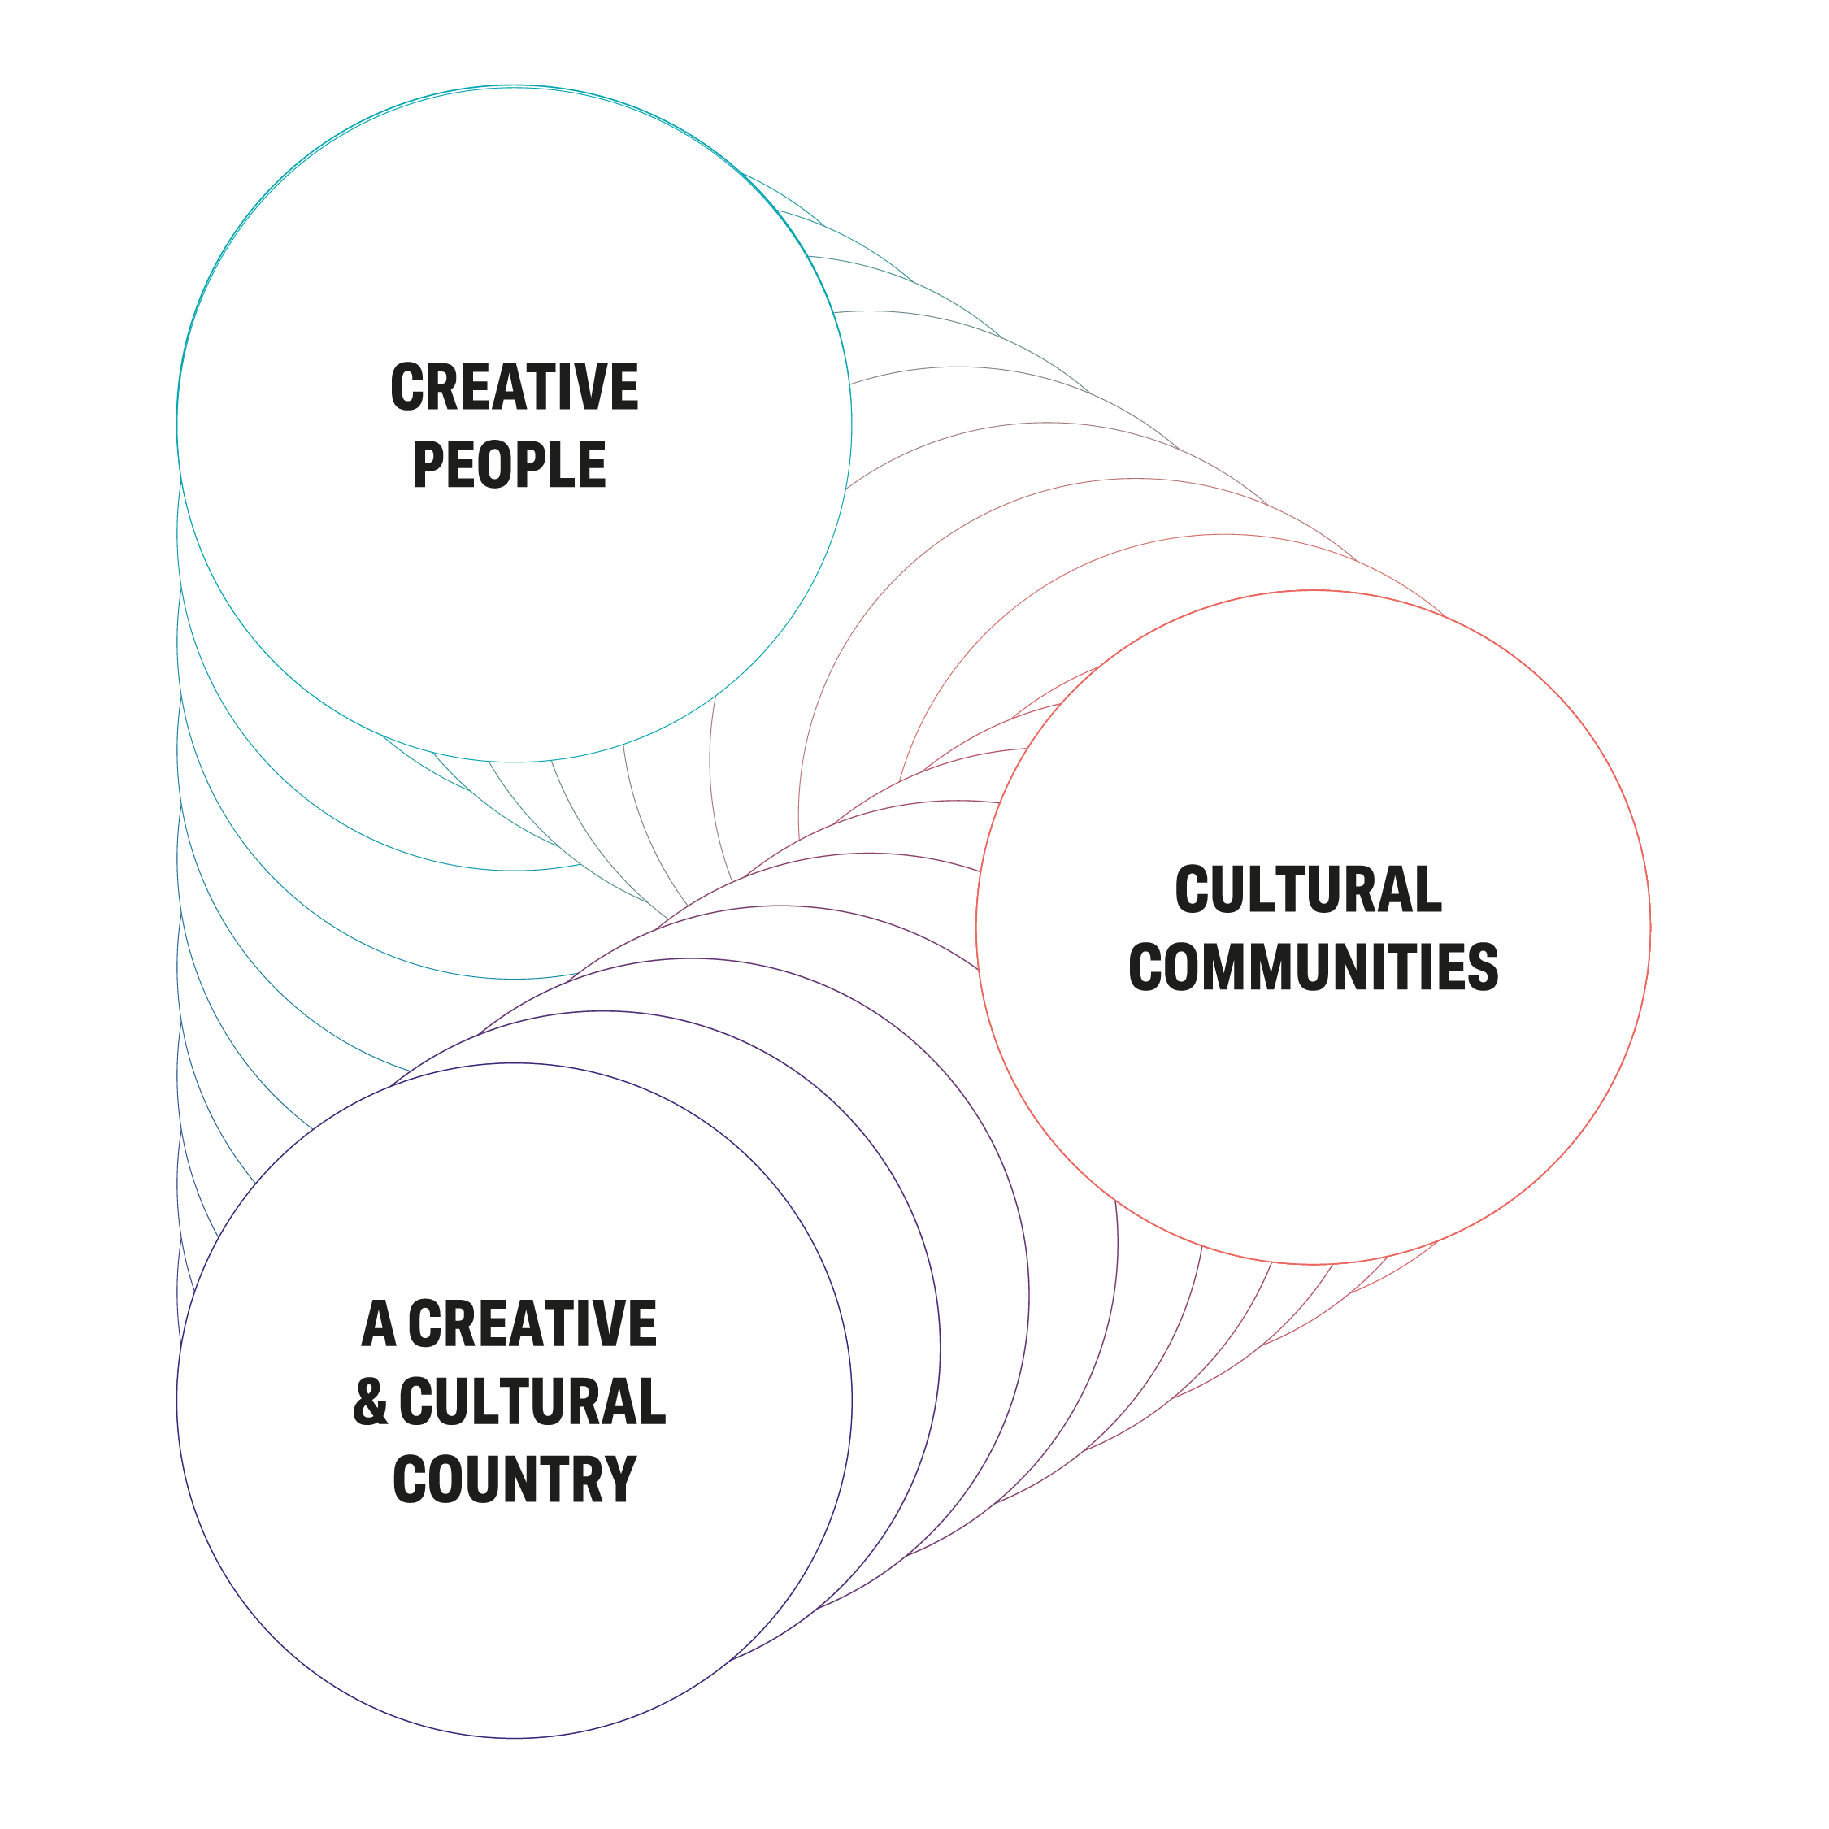
#LetsCreate
Wifi available #culturematters

Slide 6
#LetsCreate
1. Creative people
Everyone can develop and express creativity throughout their life
Everyone can be creative. Each of us has the potential to develop our creativity, and some have the talent to go much further. We want people everywhere to develop their creative skills, to make and do new things. Taking part in creative acts such as singing, photography or writing -delight and fulfil us, and helps us to think, experiment, and better understand the world.
Wifi available #culturematters

Slide 7
#LetsCreate
2. Cultural communities
More villages, towns and cities thrive through a collaborative approach to culture
Culture and the experiences it offers can have a deep and lasting effect on places and the people who live in them. Investment in cultural activities and in arts organisations, museums and libraries, helps improve lives, regenerate neighbourhoods, support local economies, attract visitors and bring people together. That impact is strongest when people feel they’ve had a say in what and how culture is programmed in their communities. This can only be achieved through long-lasting collaboration and partnerships in a place and with its people.
Wifi available #culturematters

Slide 8
#LetsCreate
.3. A creative and cultural country
England’s cultural sector is innovative, collaborative and international
To achieve the first two outcomes, we need a professional cultural sector that generates new ideas, works easily and effectively with others, and is adept at developing talent from all our communities. We will support the sector to build on its global reputation and to forge partnerships across the world. It should aspire to be world-leading – in the way it makes art; in the imagination and expertise with which it makes exciting use of our collections and develops our libraries, and in the culture it creates and distributes.
Wifi available #culturematters

Slide 9
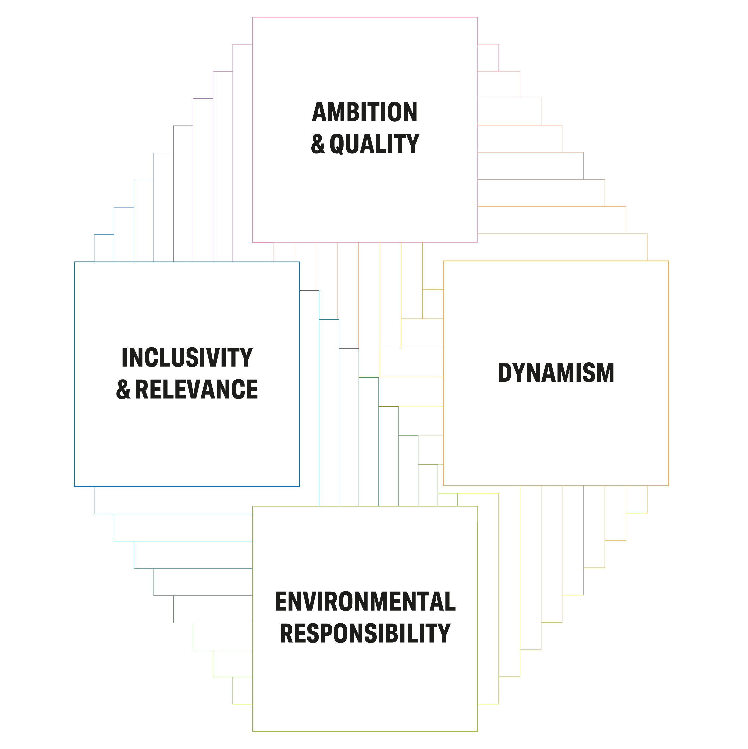
#LetsCreate
Wifi available #culturematters

Slide 10
#LetsCreate
Ambition and Quality:
Cultural organisations are ambitious and committed to improving the quality of their work
Inclusivity and Relevance:
England’s diversity is fully reflected in the organisations and individuals that we support and in the culture they produce. We want to support organisations that matter to their communities
Dynamism:
Cultural organisations are able to thrive and better able to respond to the challenges of the next decade
Environmental Responsibility:
Cultural organisations lead the way in their approach to the climate emergency
Wifi available #culturematters

Slide 11
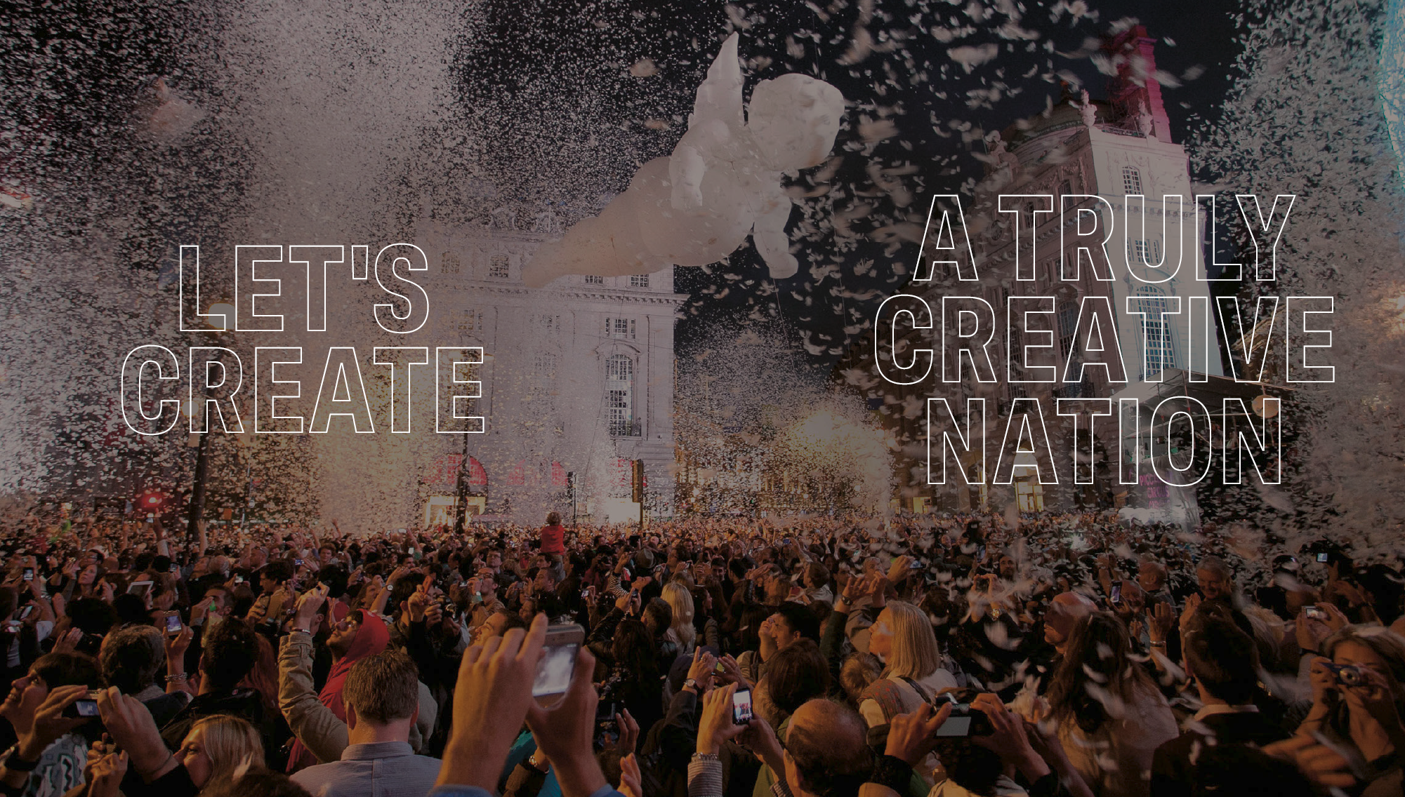
Wifi available #culturematters

